Slide 1
High Availability (HA)
What is high availability (HA) ?
High availability of a system or component assures a high level of operational performance (uptime) for a given period of time
https://www.digitalocean.com/community/tutorials/
what-is-high-availability

Slide 2
High Availability (HA)
High availability is a strategy
Fault tolerance refers to a system designed in such a way that when one component fails, a backup component takes over operations immediately to avoid loss of service

Slide 3
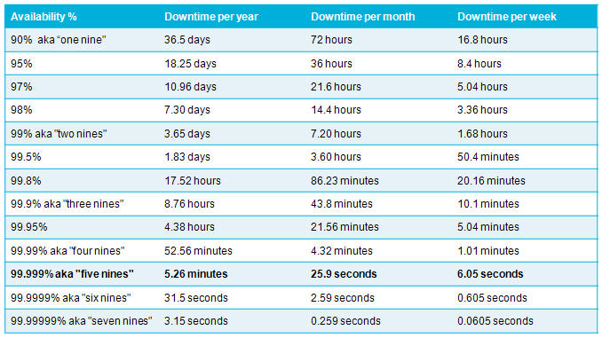
High Availability (HA)
https://jazz.net/wiki/bin/view/Deployment/HighAvailability

Slide 4
High Availability (HA)
High availability is designed in the following manner:
System level (data center or service)
Device level (within single device)
Device level (combination of multiple redundant devices)
Alternate site level

Slide 5
High Availability (HA)
High availability and fault tolerance:
Designed to minimize downtime with the help of redundant components
Disaster Recovery:
A pre-planned approach for re-establishing IT functions at an alternate site

